Slide 1
Management Principles
Developing a Quality Workforce.
Group - 7 ECE A

Slide 2
Group Members
Rhea Roy (047)
Ganni Likhit (048)
Sivaram (049)
Kunal Keshan (051)
Vaibhav Mohla (052)
Vungarala Sai Praneeth (053)
Aditya Kumar (054)

Slide 3
Introduction
Why do we need to develop a quality Workforce?
A Organization is only as successful as the people within them are.
Finding the right fit for the organisation.
Making sure that the new employees are familiar with how things work around.
Understanding Socialisation:
It's the process influencing the behaviour, expectations and attitude of the new employees and to help achieve the right fit for the job and the organization.

Slide 4
Employee Orientation
•Set of activities designed to familiarize new employees with their jobs.
•The first six months of employment are often crucial in determining how well someone will perform over the long term.
•Mission and Culture, explaining operating objectives and job expectations, communicating policies and procedures and identifying key personnel.

Slide 5
Training and Development
Training is a set of activities that provide the opportunity to acquire and improve job-related skills.
Development is any learning activity, which is directed towards future needs rather than present needs and which is concerned more with career growth than immediate performance.
Types of Training:
1. On-the-job Training
2. Off-the-job Training

Slide 6
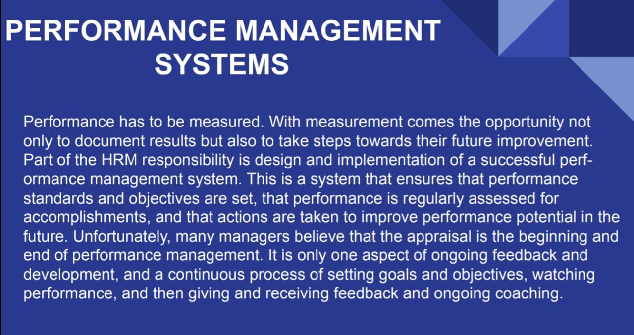

Slide 7
Purpose of Performance Appraisal
Performance evaluation is often a once-a-year addition to feedback. It does not provide continuing coaching to allow for progress, but rather assesses the employee's strengths and flaws. Because performance management includes so much more than performance appraisal, an appraisal is an important aspect of it. Performance evaluation is the practise of formally assessing someone's work accomplishments and delivering comments. It has two primary functions in maintaining a high-quality workforce: evaluation and development. The goal of the evaluation is to let people know where they are in relation to performance goals and criteria. The goal of the development purpose is to help them with their training and personal development. The goal of performance appraisal is to evaluate past performance and compare results to criteria.Performance is recorded for the record as well as to build a foundation for determining awards. The manager takes on a judgmental position, giving a direct assessment of another person's accomplishments. On the other side, the development objective of performance appraisal is to clarify success standards and future performance. It's a method of finding performance barriers and training and development opportunities. In this case, the manager takes on the role of a counsellor, focusing on a subordinate's developmental needs. Any performance appraisal system, like employment tests, can only achieve these goals if the requirements for reliability and validity are met.To be valid, the method must be unbiased and measure only aspects directly related to work performance. To be trustworthy, the approach must consistently provide the same result across time and/or for different raters. Any contested evaluations will require written verification of performance appraisals as well as a record of consistent past actions.

Slide 8
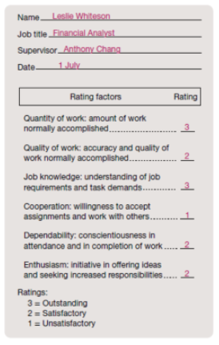
Performance Appraisal Methods
Organisations use many methods, one of the most simplest methods are Graphic Rating Scale.
Offer appraisers a checklist of traits to be related to high-performance outcomes in a given job.
Manager rates individuals on each trait using a numeric score.
It’s relatively easy to use, quick to fill however their reliability and validity are questionable because every manager might have a different interpretation of their employees!

Slide 9
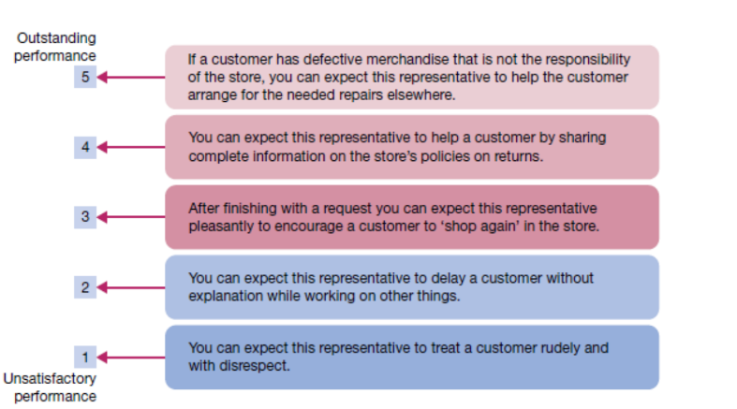
Sample Behaviour Anchored Rating Scale for Performance Appraisal

Slide 10
Critical Incident Technique
This technique involves keeping a running log or inventory of effective and ineffective job behaviours.
It documents success or failure patterns that can further be discussed with the individuals.

Slide 11
Multiperson Comparisons
This technique formally compares one person’s performance with that of one or more others.
Can be used on its own or be combined with other methods.
Different ways it can be done in
Rank Ordering - arranged in order of performance achievement
Paired Comparisons - compared with every other person and rated as the superior or weaker one in the pair
Forced Distribution - placed into a frequency distribution that requires that a certain percentage fall into specific performance classifications
Peer Appraisal - including those who work directly with a job holder
Upward Appraisal - including subordinates reporting to the job holder
360° feedback - including superiors, subordinates, peers, external and internal customers

Slide 12
Conclusion
To summarise,
Developing a quality workforce is one of the most important tasks of an organization.
It begins with their orientation which further leads to their training and development ~ done on-the-job and off-the-job.
Eventually, their performance has to be measured which is done with the implementation of a performance management system.
Providing feedback to the individual’s performance is known as performance appraisal and there are several techniques to this.
Performance appraisals have 2 purposes in the maintenance of a quality workforce : evaluation and development.

